Slide 1

Pedestrian Detection in Challenging Scenarios: A Deep Learning Approach on PIE Dataset
Group – 11
Hruthika Jinna – 2151639
Sathya Lahari Nuka – 2200736
Veera Sampath Kumar Reddy – 2199279
Sai Sathvik Garla – 2150895

Slide 2
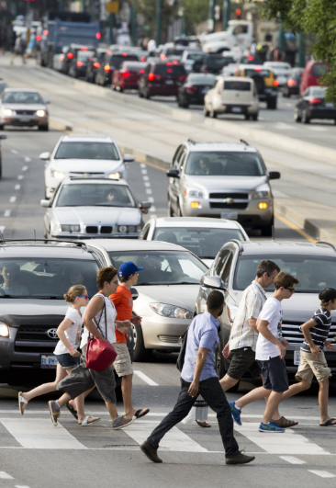
ABSTRACT
Pedestrian counting - an important task in various applications, including urban planning, transportation, and crowd management.
The goal of pedestrian counting is to accurately estimate the number of pedestrians that pass through a certain area at a specific time.
This information can be used to optimize traffic flow, identify busy areas, and improve safety measures.

Slide 3
INTRODUCTION
PIE (Pedestrian Intensity Estimation) - a large-scale dataset used where set of models designed for the task of pedestrian counting.
Created to address the need for more accurate and reliable pedestrian counting methods, particularly in urban environments where pedestrian traffic can be dense and varied.

Slide 4
LITERATURE REVIEW
The PIE dataset has been used in several studies for pedestrian counting, detection, tracking, and action prediction.
In a study by Tan et al. (2019)
A deep learning-based pedestrian detection and tracking algorithm was proposed and evaluated on the PIE dataset.
The algorithm achieved high accuracy in both detection and tracking tasks and was able to handle occlusions and complex pedestrian behaviors
In a study by Shafaei et al. (2020),
A novel approach for pedestrian action prediction was proposed, which utilizes spatial and temporal information in the PIE dataset.
The proposed approach achieved state-of-the-art results in pedestrian action prediction tasks.

Slide 5
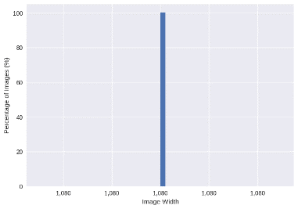
Dataset
The PIE dataset
Large dataset
Consists of over 6 hours of driving footage captured in downtown Toronto using a calibrated monocular dashboard camera.
Videos were recorded in HD format at 30 frames per second and split into approximately 10-minute long chunks.
Footage captured with calibrated monocular dashboard camera Waylens Horizon equipped with 157◦ wide angle lens.
All videos are recorded in HD format (1920 × 1080 px) at 30 fps.
The camera was placed inside the vehicle below the rear-view mirror.
Contains a wide range of pedestrian behaviors and locations, including areas with high foot traffic and narrow streets, as well as wide boulevards with fewer pedestrians.

Slide 6
Slide 1
Data
Split the data
Models
Predicting
Visualization
Evaluation
Collecting the data and performing preprocessing
Train and test data split
Building the models.
Building the models on tarin and test data.
Visualizing the results of train and test
Evaluation of results using f1-score, precision
Steps involved
Images configuration (1024x1920 pixels split = 0.2)
Image Augmentation
Training images
Testing images
Run fiftyone
Detectron2 training
Evaluate model performance
When scaling, group all elements to be scaled. Scale as needed. Use the “Increase Font Size,” “Decrease Font Size” buttons or manually change the font size for the editable text. Delete unwanted elements. Change the line weight of the circles or connecting bars as needed.

Slide 7
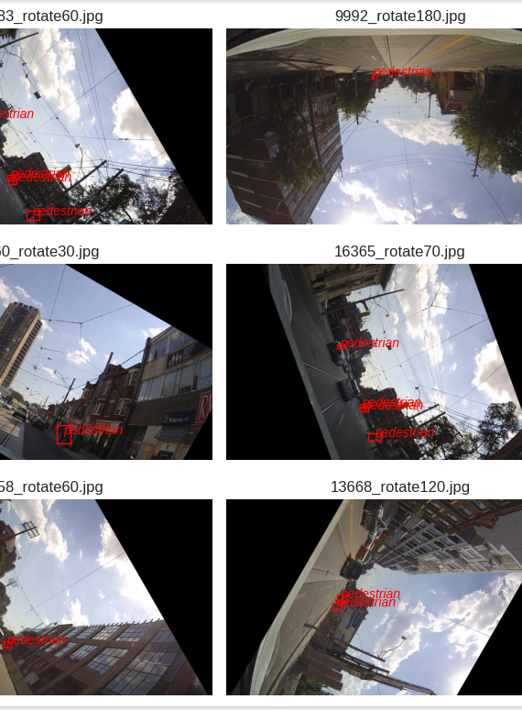
Image Augmentation
We utilized the imgaug library to augment our image dataset by applying various transformations such as rotation, cropping, and scaling to create new synthetic images.
Augmentation helps to expand the dataset and prevent overfitting when training machine learning models that use image data.
We used the COCO format to represent object detection and segmentation datasets by creating JSON files that contain information about the objects in each image, including their location and class labels.
Although this process can be time-consuming, it is crucial in preparing a dataset for machine learning tasks that involve object detection or segmentation.

Slide 8
Training and Testing Stages
Training: To display the ground truth annotation file, the script visualizes object detection results on a set of images by extracting bounding box coordinates and object names from the corresponding XML annotation files. The resulting visualizations are displayed in a 4x4 grid using matplotlib
Testing: To perform object detection on a set of images using a pre-trained Faster R-CNN model, the script defines a function that takes in a Detectron2 predictor and an image path and returns the predicted object bounding box coordinates and object names.. The resulting images with the predicted object bounding boxes and object names are displayed in a 4x4 grid.

Slide 9
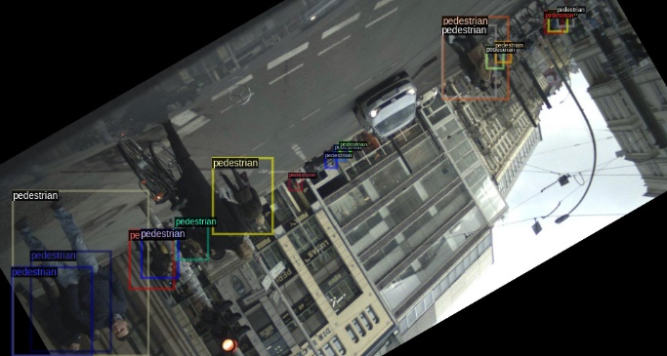
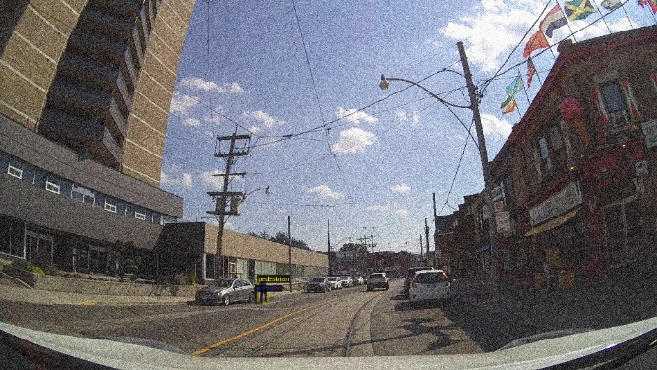
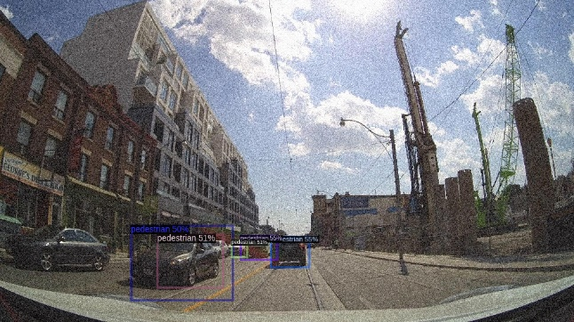
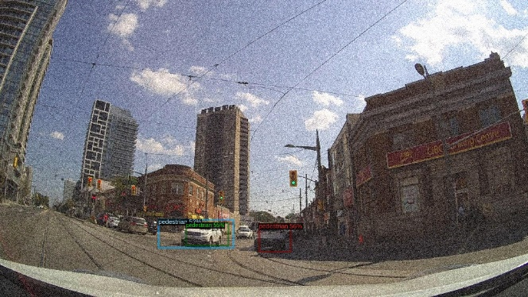
Training Images:
Testing Images:

Slide 10
Evaluation using IOU metrics:
To evaluate object detection performance using the IoU metric
The script extracts the ground truth object coordinates and names from the corresponding XML files and uses a pre-trained object detection model to extract the predicted object coordinates and names for each image.
The script checks if there is a matching predicted object for each ground truth object using the bb_intersection_over_union function, and if the IoU score is greater than or equal to the threshold of 0.5, the predicted object is considered a match.
Finally, the script generates a classification report using the scikit-learn metrics module, which computes precision, recall, f1-score, and support for each class based on the matching objects.

Slide 11
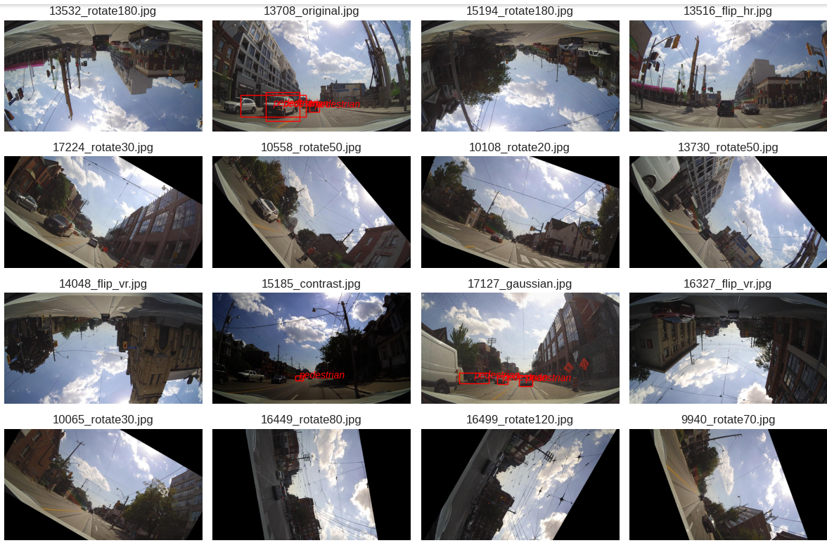

Slide 12

CONCLUSION
Our experiments showed that the performance of the models varied depending on the pedestrian scenarios, with better performance on images with fewer pedestrians and less occlusion.
We also found that data augmentation techniques, such as rotation, scaling, and cropping, can be effective in improving the model's performance and generalization ability.

Slide 13
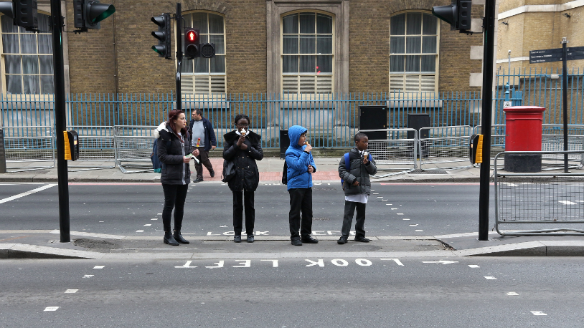
Thank You

